Slide 2
WHY WE’RE HERE
Exclusive 15% tuition discount for PITT-OHIO Employees, Spouses, and Dependents
Applies to ALL RMU Programs!

Slide 3
WHY RMU? PROFESSIONALLY FOCUSED

Slide 4
APPLIED ARTIFICIAL INTELLIGENCE
CYBERSECURITY
DATA ANALYTICS
DATA SCIENCE
BACHELORS, MASTERS, AND CERTIFICATE OPTIONS

Slide 5
MBA
UNDERGRADUATE BUSINESS
CERTIFICATE PROGRAMS

Slide 6
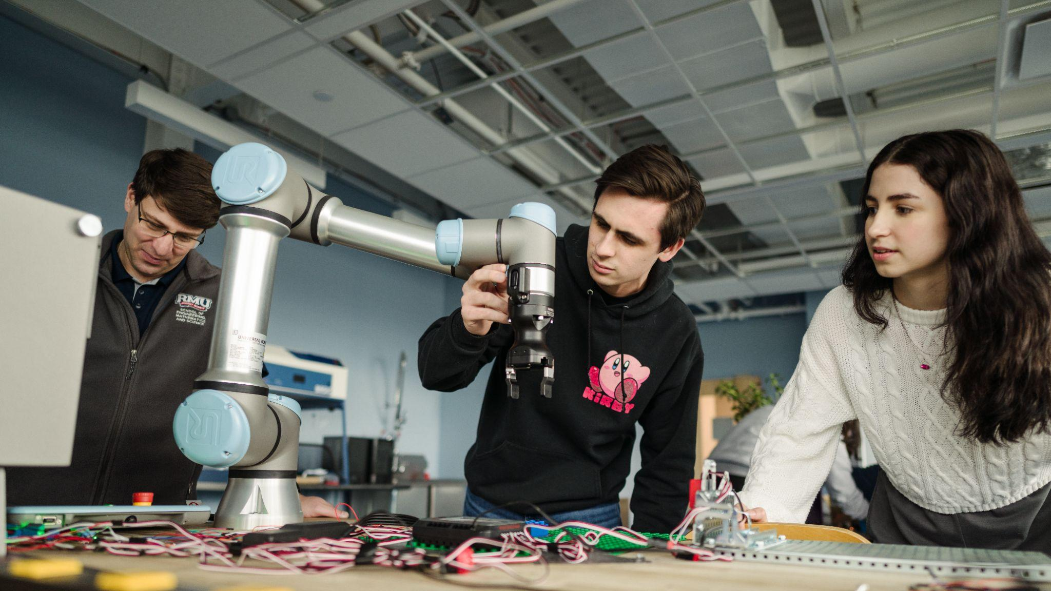
ENGINEERING
BACHELORS, MASTERS, AND CERTIFICATE OPTIONS

Slide 7
NURSING
HEALTH SCIENCES
HEALTHCARE ADMINISTRATION
PSYCHOLOGY
BACHELORS, MASTERS, AND CERTIFICATE OPTIONS

Slide 8
WHY RMU? STACKABLE
CREDENTIALS

Slide 9
UNDERGRADUATE AND GRADUATE CERTIFICATE PROGRAMS
Most undergraduate and graduate level certificates integrate seamlessly into degree programs
Students can use them as stand-alone certificates, or continue on and use the coursework to meet degree requirements for various programs
Most certificates range between 9–15 credits (3-5 classes)

Slide 10
WHY RMU? FLEXIBLE & AFFORDABLE

Slide 11
WHY RMU? FLEXIBLE & AFFORDABLE
ONLINE, ON-GROUND, AND HYBRID OPTIONS
TAKE AS LITTLE AS ONE COURSE AT A TIME
CLASSES START EVERY 8 WEEKS

Slide 12
WHY RMU? WE’RE SERIOUS ABOUT YOUR SUCCESS

Slide 13
WE’RE SERIOUS ABOUT YOUR SUCCESS
HIGHLY INDIVIDUALIZED APPROACH
DEDICATED ACADEMIC ADVISOR
CONCIERGE SERVICE FOR PITT-OHIO EMPLOYEES AND FAMILIES

Slide 14
WHAT NEXT?
EXPLORE your options with a dedicated enrollment advisor.
APPLY to RMU for free.
ENROLL in classes at RMU.
FUND your education with your tuition discount and help from our financial aid specialists.

Slide 15
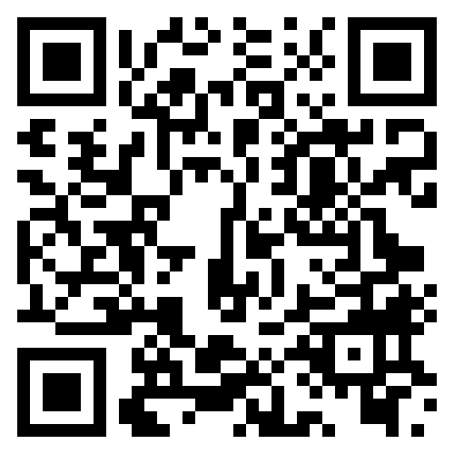
QUESTIONS?
REGISTER AND CONTACT RMU.EDU/PITTOHIO
412-397-3339

